Slide 1
Smart Compression Framework for IoT Sensor Healthcare Data using Adaptive Modelling
ADVANCED DATA COMPRESSION TECHNIQUES

Slide 2
TEAM MEMBERS
ANIRUDHAN R (22MIC0067)
RAVISHANKAR G (22MIC0034)
THARUN R (22MIC0061)
I MOHAMED ISRAAR (22MID0101)

Slide 3
INTRODUCTION
The Internet of Things (IoT) generates a massive amount of real-time data from sensors such as temperature monitors, heart rate trackers, and oxygen level detectors. Healthcare applications require fast, secure, and efficient data transmission. However, IoT networks face challenges like limited bandwidth, congestion, latency, and high energy consumption. Data compression at the IoT layer before transmission to fog/cloud servers can significantly reduce these issues.
This project is based on the research paper “Design an Efficient Internet of Things Data Compression for Healthcare Applications” (Bulletin of Electrical Engineering and Informatics, 2022), which proposes a compression-based IoT–fog computing system using the Zstandard algorithm.

Slide 4
EXISTING METHODOLOGY
    EXISTING IOT CHALLENGES
  IoT sensors generate large volumes of data continuously.
  Bandwidth limitations cause network congestion.
  Latency in transmission impacts patient monitoring.
  Cloud-only processing creates delays and increases costs.

Slide 5
EXISTING COMPRESSION TECHNIQUES
Huffman + LZW (Hybrid Compression) → Achieved ~64% compression ratio.
Clustering + Huffman Encoding (EEG Data) → Reduced transmission size by grouping
similar signals.
SAX + LZW (CBDR Method) → Two-phase lossy+lossless approach with >95% ratio.
GROWN (WBAN Compression) → Reduced redundancy in wearable sensor data.

Slide 6
WHY PROPOSED METHODOLOGY WORKS BETTER
These methods improved compression but often required high computation, large memory, or longer execution time, making them less suitable for IoT devices with limited resources.

Slide 7
PROPOSED METHODOLOGY
The proposed approach uses the Zstandard (Zstd) algorithm for real-time lossless data compression in IoT healthcare.
System Flow
IoT Layer (Raspberry Pi)
  Sensors:
    DS18B20 – Temperature
    MAX30100 – Oxygen & Heart Rate
  Collect raw sensor data.
  Compress data using the Zstandard algorithm.
  Send compressed data via wireless socket to Fog node.
Fog Layer (Server / PC)
  Receive compressed data.
  Decompress using Zstandard.
  Store and analyze results.
  Evaluate system performance (compression ratio, throughput, latency).

Slide 8
ALGORITHMS
4.1 Compression (Zstandard Algorithm – Lossless)
Reads input data streams.
Identifies repeated patterns.
Builds dictionary-based encoding.
Outputs compressed binary sequence.

Slide 9
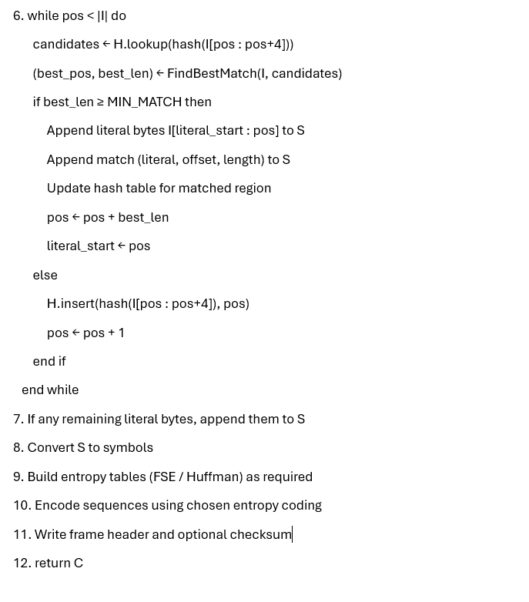
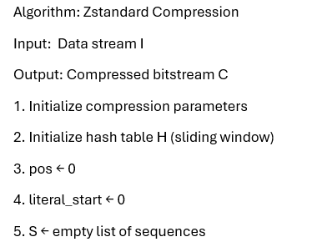
PSEUDOCODE

Slide 10
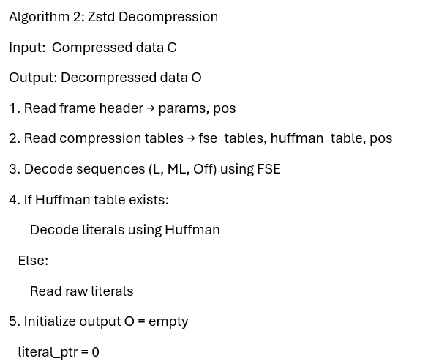
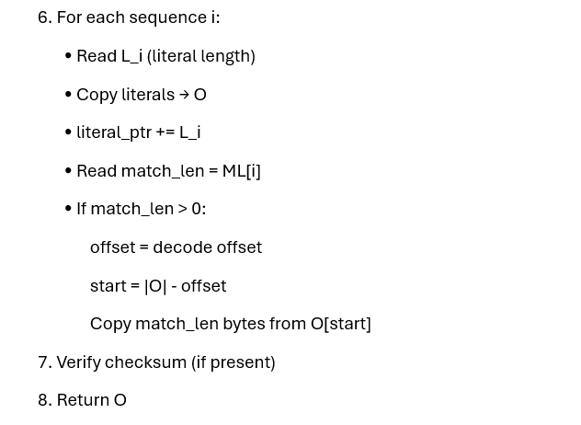
PSEUDOCODE

Slide 11
BENEFITS OF PROPOSED METHOD
High Compression Ratio: Up to 70% reduction in data size.
Faster Throughput: ~85.43 B/ms for 100 sensor reads (better than uncompressed).
Low Latency: Constant 6.25 ms fog processing delay.
Lightweight: Uses less CPU/RAM than Huffman or LZW.
Scalable: Works with multiple IoT sensors and datasets.
Real-Time Performance: Suitable for continuous patient monitoring.

Slide 12
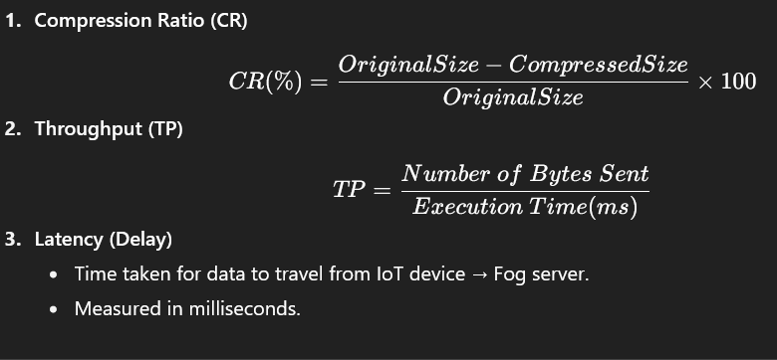
EVALUATION METRICS

Slide 13
APPLICATIONS
Smart Healthcare – Continuous monitoring of patients with low bandwidth.
Wearable Devices – Reduce redundancy and energy consumption.
Smart Cities / Homes – Compress large sensor data streams (temperature, humidity, etc.).
Emergency Response Systems – Fast, real-time, low-latency transmission of vital signs.

Slide 14
CONCLUSION
The proposed project implements a Zstandard-based IoT healthcare compression system. By compressing data at the IoT layer before transmitting to fog computing, it reduces bandwidth usage, network congestion, and processing delays. Compared to traditional methods (Huffman, LZW), the Zstandard approach provides better compression ratio, throughput, and latency while being lightweight enough for IoT devices.
This makes the system practical for real-world healthcare monitoring applications.

